Slide 1
Real Estate Investment Opportunities in 2025
Andrew Cheng
Paul Samaniego
Riya Gajjar
Madeline Cruz

Slide 2
Summary Statistics

Slide 3
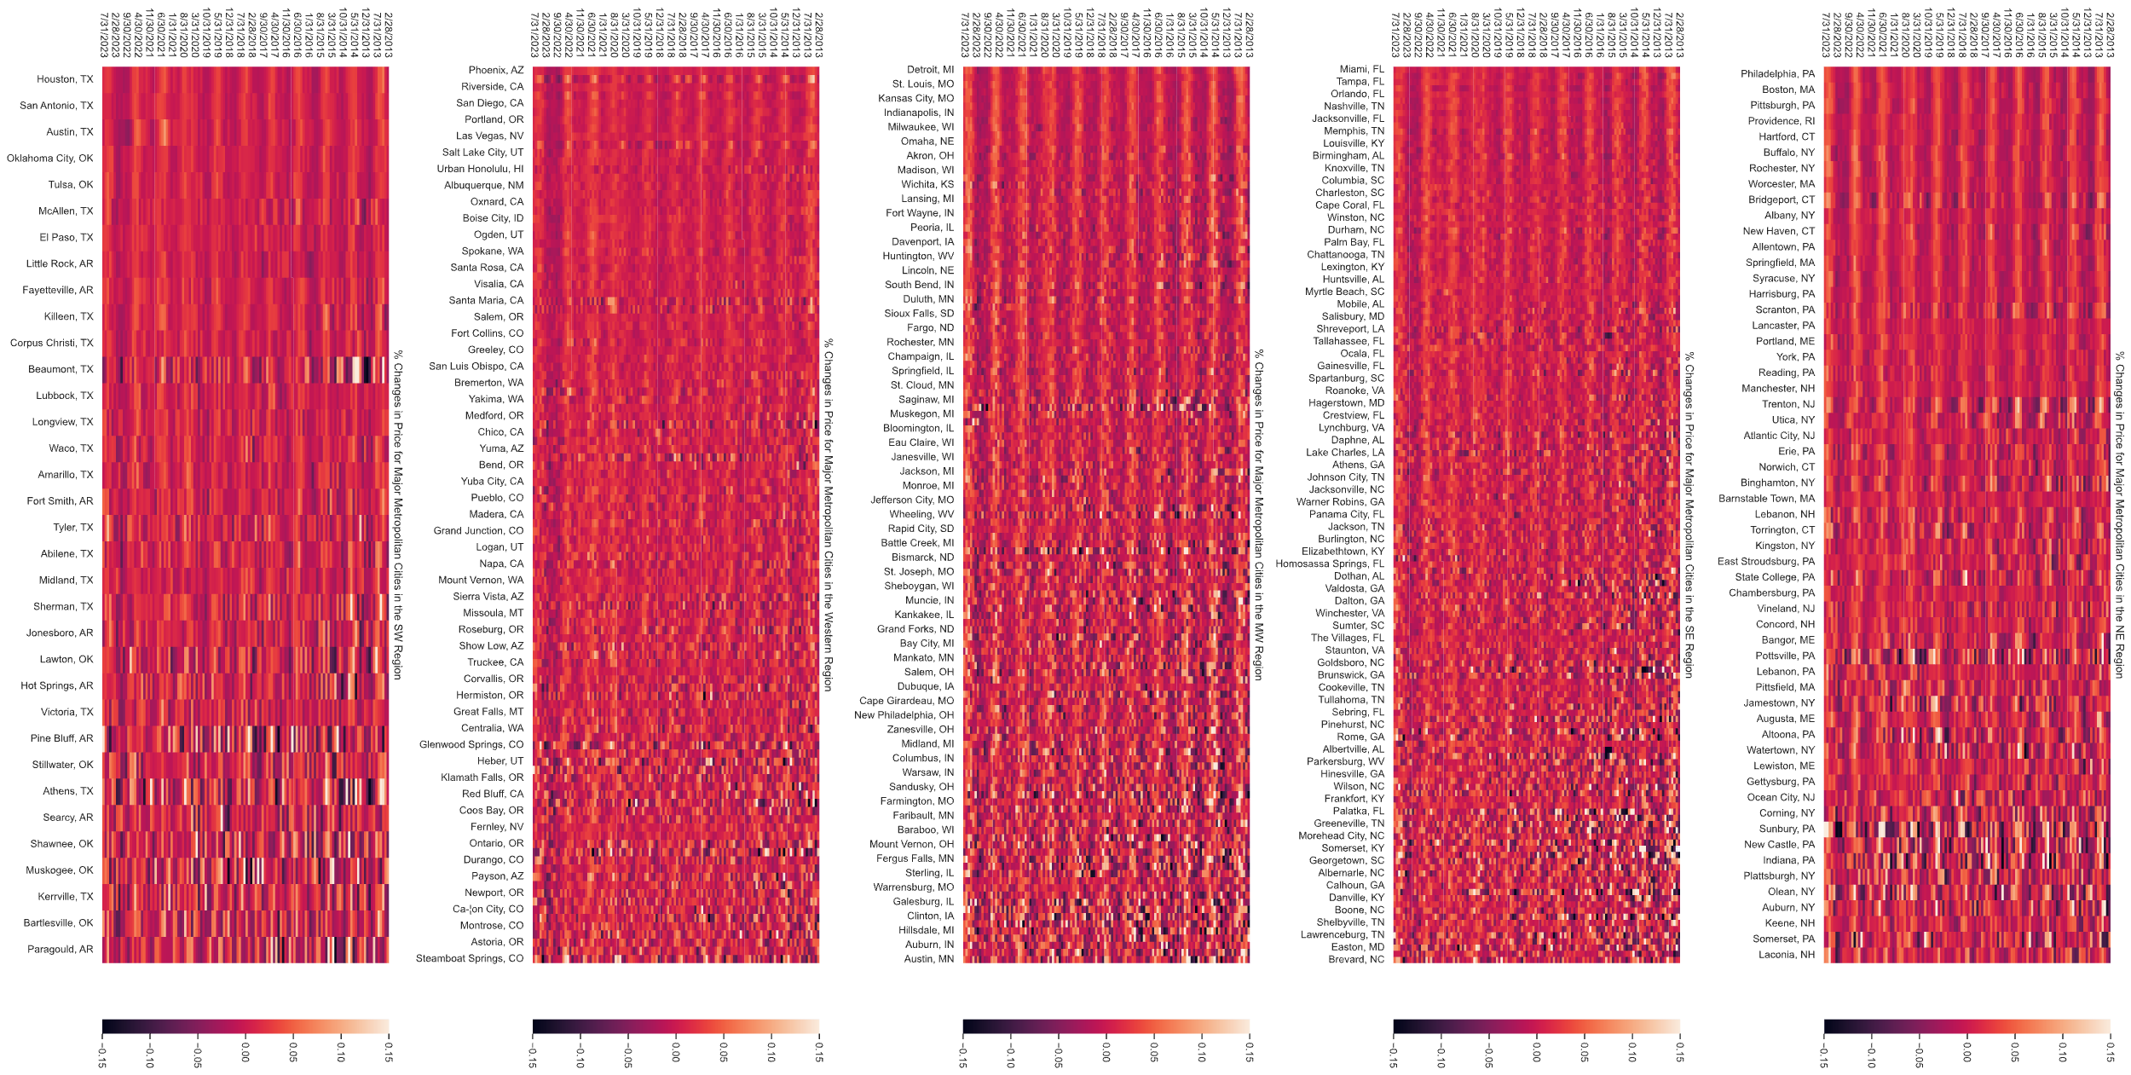
Market Volatility

Slide 4
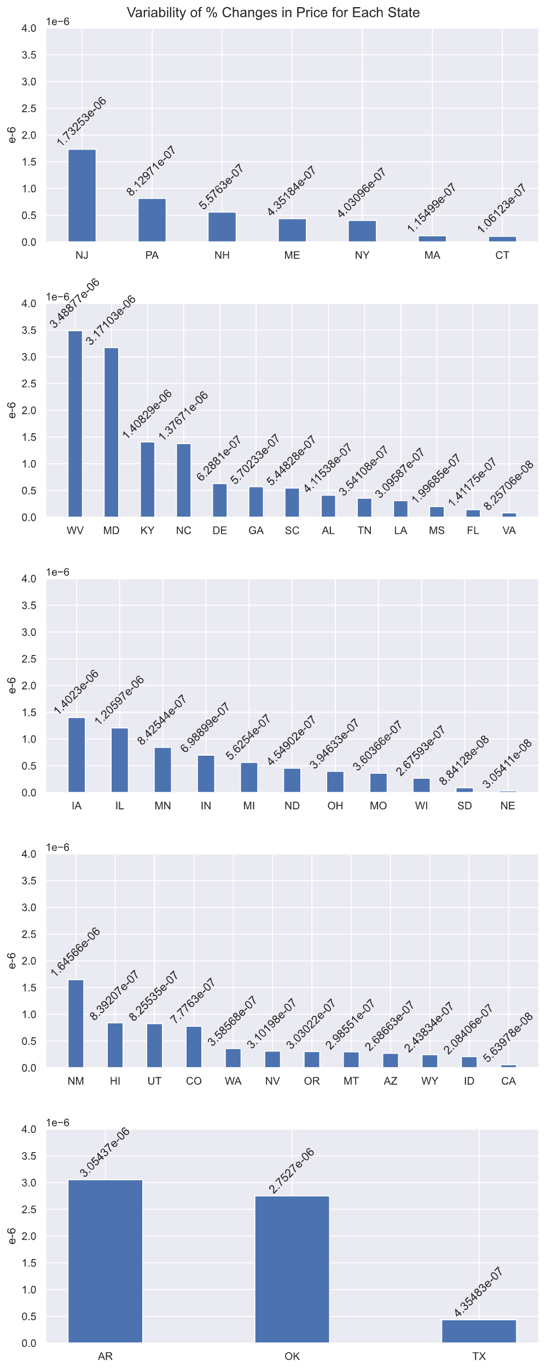
Volatility of Individual States Grouped by region

Slide 5
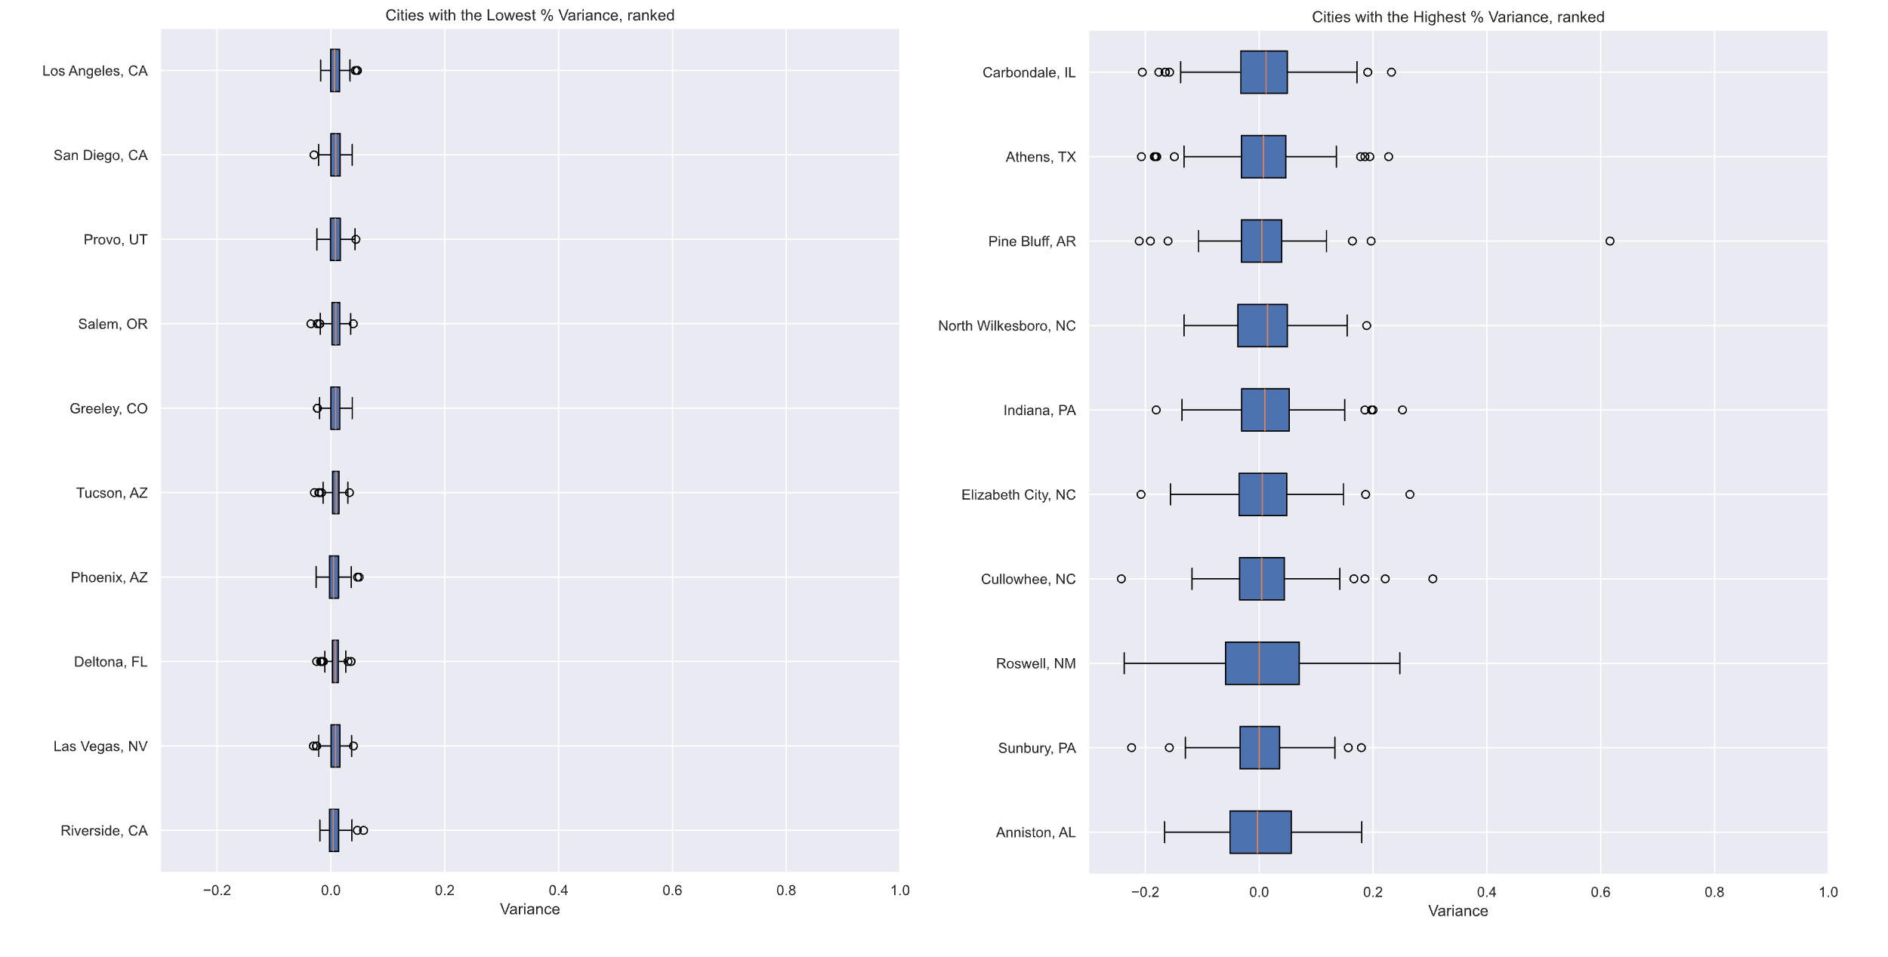
Most Stable City Prices, Historic
Most Volatile City Prices, historic

Slide 6
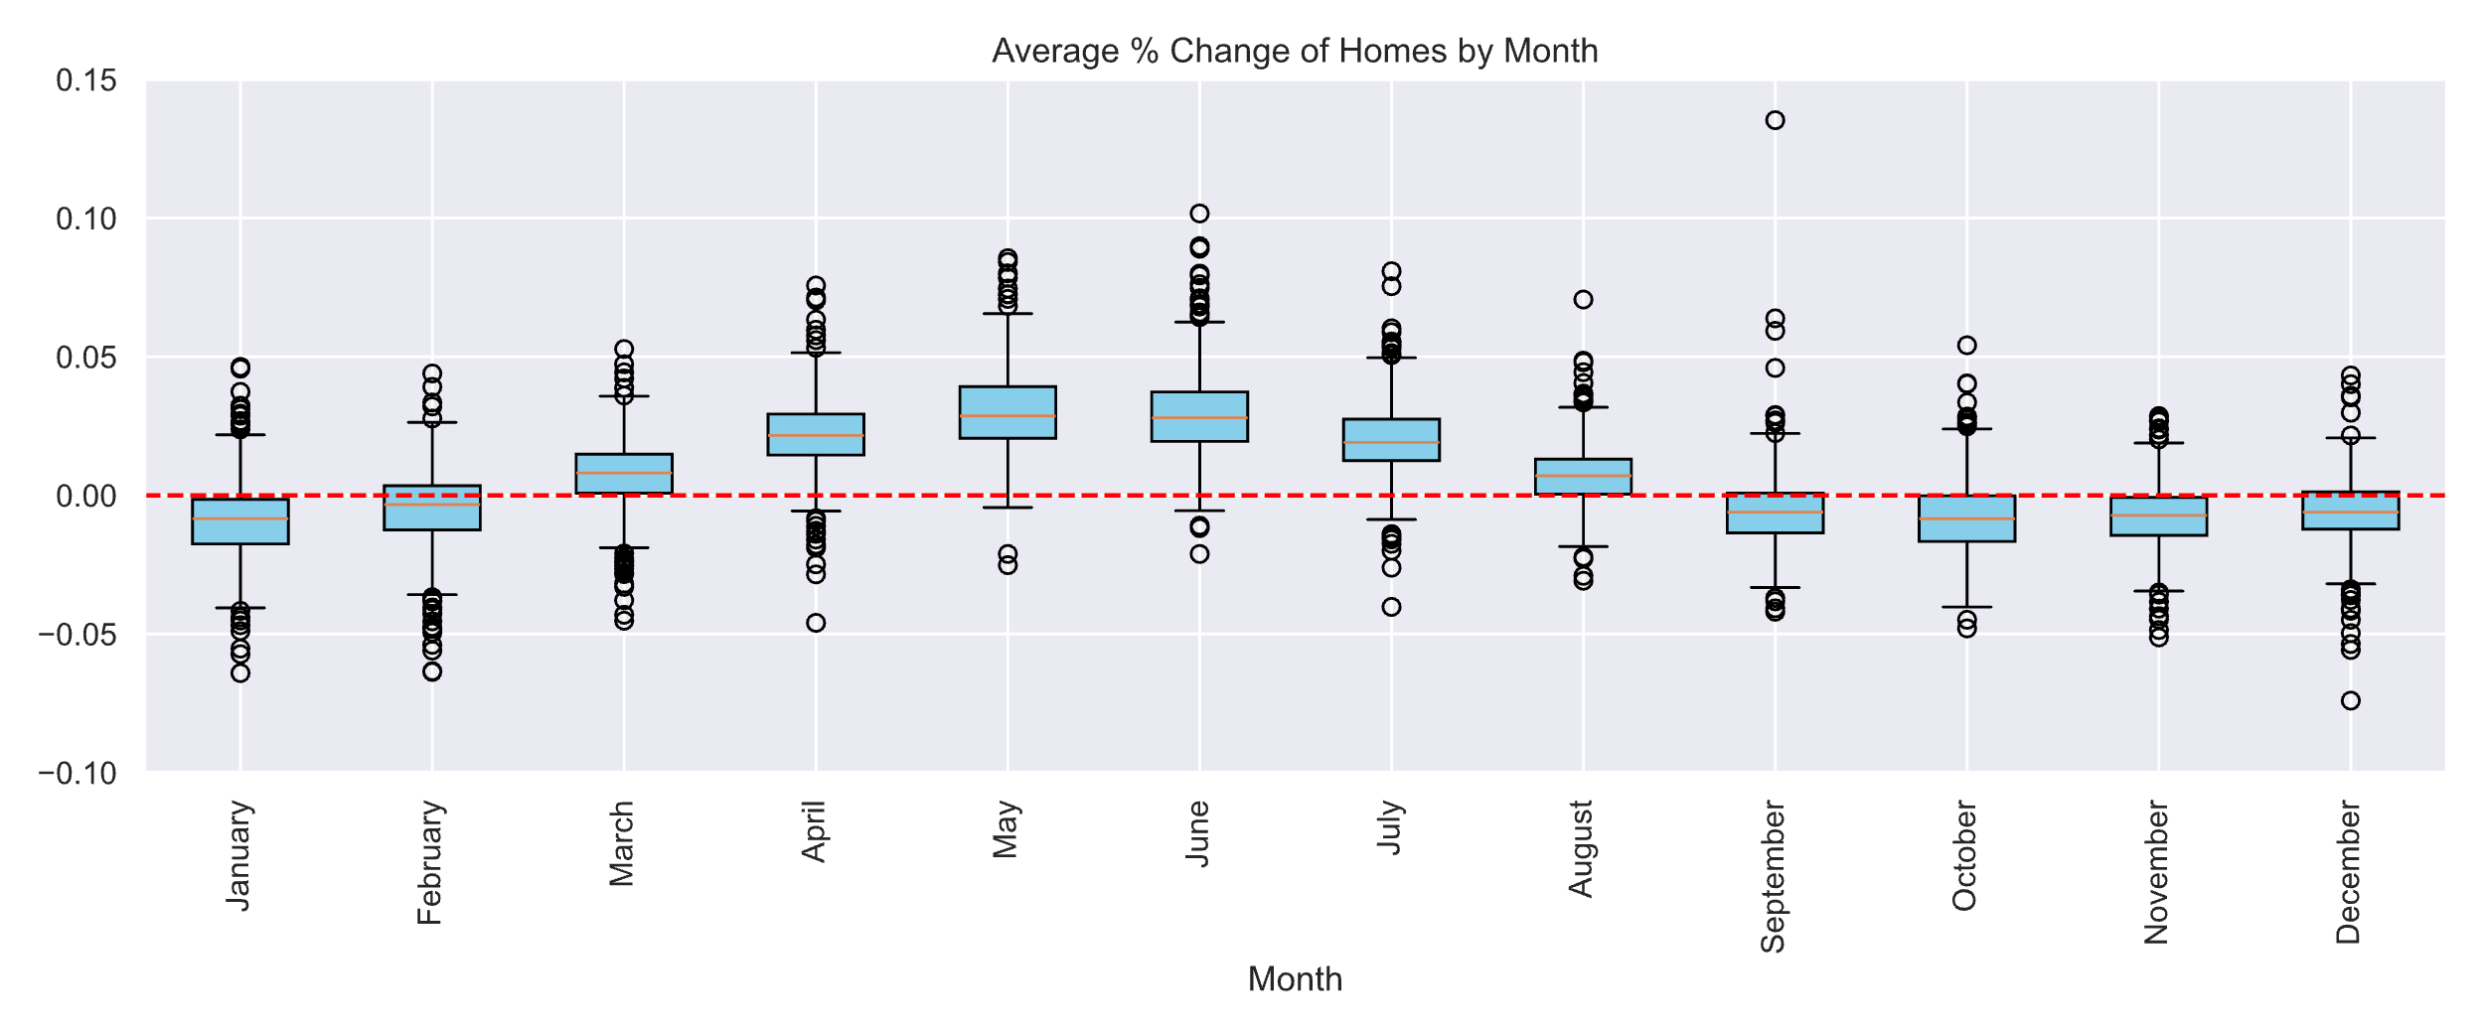
Most Volatile Months, Historic

Slide 7
Hypothesis Testing

